Slide 1
CSIT 200 Week 13 Searching and sorting
Python Programming
LinDa Yang
W-307

Slide 2
outline
Selection sort
Analyzing the performance of the selection sort algorithm
Searching
Problem solving: estimating the running time of an algorithm
Big “O” notation

Slide 3

Selection sort
Sorts a list by repeatedly finding the smallest element of the unsorted region and moving it to the front
Example: sorting a list of integers

Slide 4


Selection sort
Find the smallest and swap it with the first element
Find the next smallest. It is already in the correct place
5 | 9 | 17 | 11 | 12
Find the next smallest and swap it with first element of unsorted portion
5 | 9 | 11 | 12 | 17
When the unsorted portion is of length 1, we are done
5 | 9 | 11 | 12 | 17

Slide 5
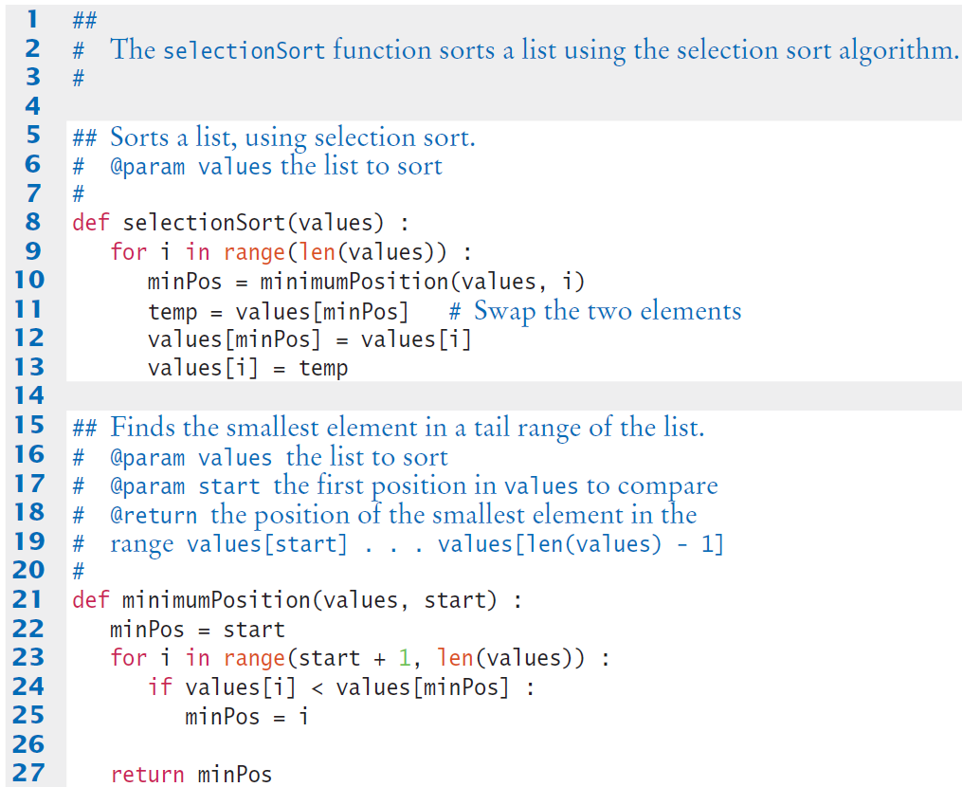
Selectionsort.Py
Continued

Slide 6
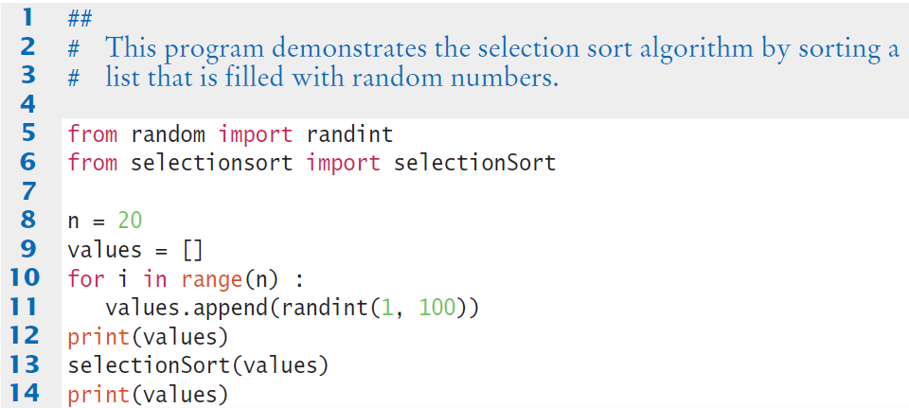
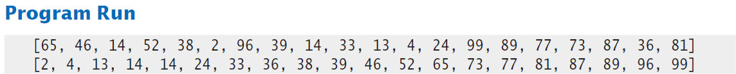
Selectiondemo.Py

Slide 7
Measuring the Selection Sort Algorithm
Want to measure the time the algorithm takes to execute
Exclude the time the program takes to load
Exclude user input
Exclude output time
To measure time elapsed:
Use the time() library function from the time module.
It returns the seconds that have elapsed since midnight at the start of January 1, 1970.
The difference of two such counts gives us the number of seconds in a given time interval.

Slide 8
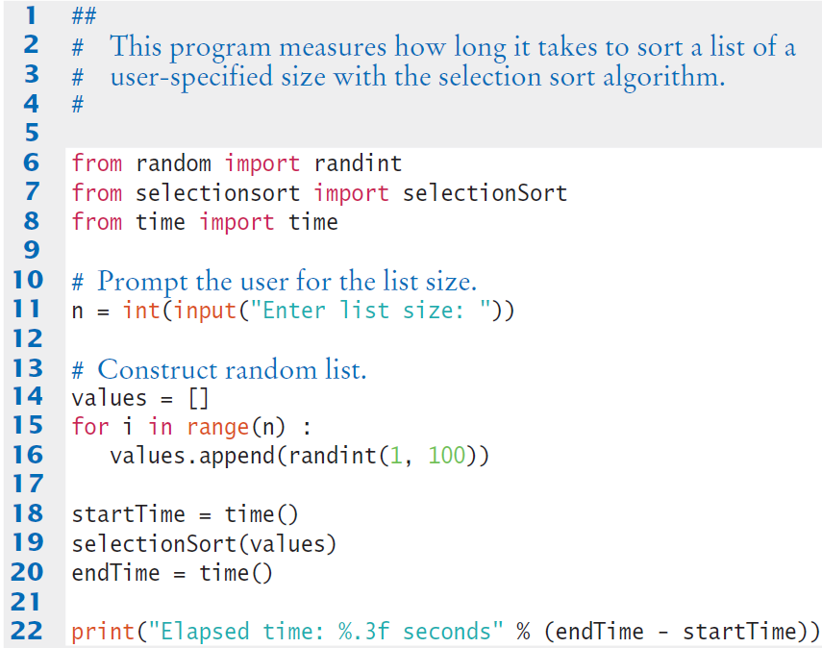
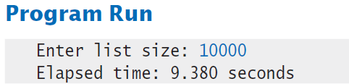
Selectiontimer.Py

Slide 9
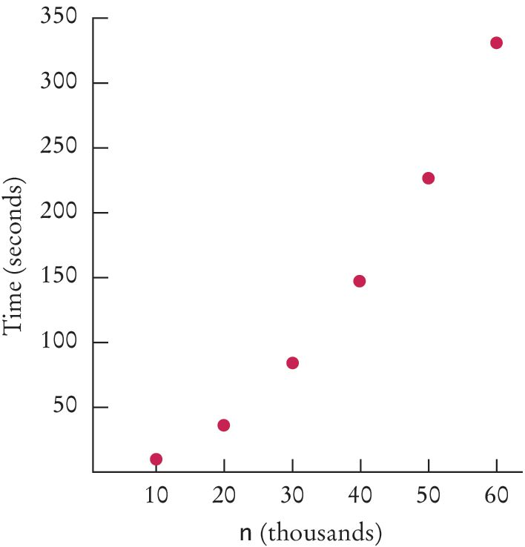
Time Taken by Selection Sort
List size (n) | Seconds
10,000 | 9
20,000 | 38
30,000 | 85
40,000 | 147
50,000 | 228
60,000 | 332
These measurements were obtained with an Intel dual core processor with a clock speed of 3.2 GHz running Python 3.2 on the Linux operating system.

Slide 10
Big-Oh Notation
Computer scientists use the big-Oh notation to describe the growth rate of a function
Selection sort is an O(n²) algorithm. Doubling the data set means a fourfold increase in processing time

Slide 11
Searching
Linear search: examines all values in a list until it finds a match or reaches the end
Also called sequential search
Number of visits for a linear search of a list of n elements:
The average search visits n/2 elements
The maximum visits is n
A linear search locates a value in a list in O(n) steps

Slide 12
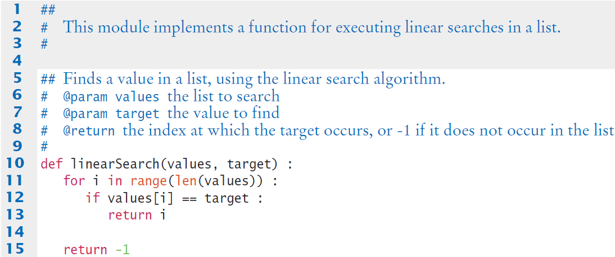
Linearsearch.py

Slide 13
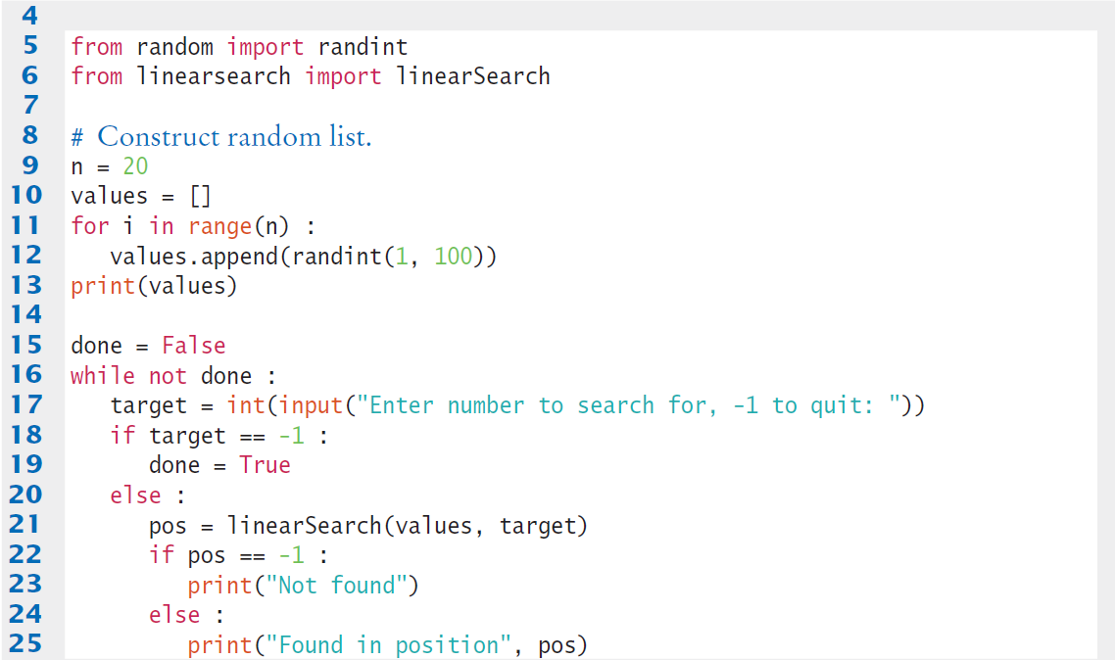
linearDemo.py

Slide 14
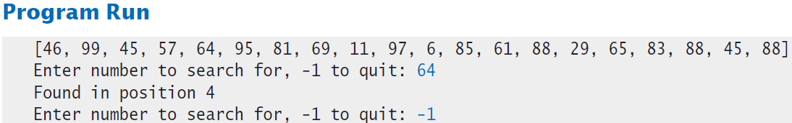
LINEAR SEARCH: RESULTS

Slide 15
Linear Time
An algorithm to count how many elements of a list have a particular value:
count = 0
for i in range(len(values)) :
if values[i] == searchedValue :
count = count + 1

Slide 16
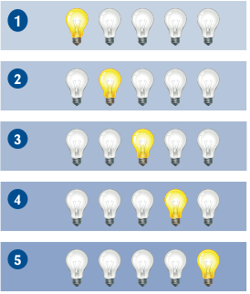
Linear Time
To visualize the pattern of list element visits:
Imagine the list as a sequence of light bulbs
As the i^{th} element gets visited, imagine the i^{th} light bulb lighting up
When each visit involves a fixed number of actions, the running time is n times a constant, or O(n)

Slide 17
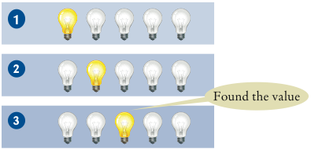
Linear Time
When you don’t always run to the end of the list; e.G.:
found = False
i = 0
while not found and i < len(values) :
if values[i] == searchedValue :
found = True
else :
i = i + 1
Loop can stop in middle:
Still O(n), because in some cases the match may be at the very end of the list

Slide 18
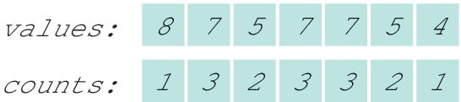
Quadratic Time
What if we do a lot of work with each visit?
Example: find the most frequent element in a list
Obvious for small list
For larger list?
Put counts in a second list of same length
Take the maximum of the counts, 3, look up where the 3 occurs in the counts, and find the corresponding value, 7

Slide 19
Quadratic Time
First estimate how long it takes to compute the counts
for i in range(len(values)) :
counts[i] = Count how often values[i] occurs in values
Still visit each element once, but work per visit is much larger
Each counting action is O(n)
When we do O(n) work in each step, total running time is O(n²)

Slide 20
Quadratic Time
Algorithm has three phases:
Compute all counts
Compute the maximum
Find the maximum in the counts
First phase is O(n²), second and third are each o(n)
The big-Oh running time for doing several steps in a row is the largest of the big-Oh times for each step
Thus algorithm for finding the most frequent element is O(n²)

Slide 21
summary
Algorithms should be measured for their number of steps and time.
The big-Oh notation can be used to determine a growth rate of the algorithm’s progression.

